Slide 1

Amazon Analysis Sales Report

Slide 2
Comprehensive Analysis Summary
Key Findings :
Shirts and T-shirts are the top-performing categories
Sizes M, L, XL dominate orders
Amazon-fulfilled orders show higher revenue and delivery success
Insights :
Maharashtra and Karnataka drive the most revenue
High-value orders (> 1,000) account for a significant share of revenue
B2B orders are fewer, but have higher average order values
Recommendations:
Prioritize inventory for top categories and sizes
Target B2B customers with bulk deals and exclusive offers
Use regional strategies for ads and promotions

Slide 3
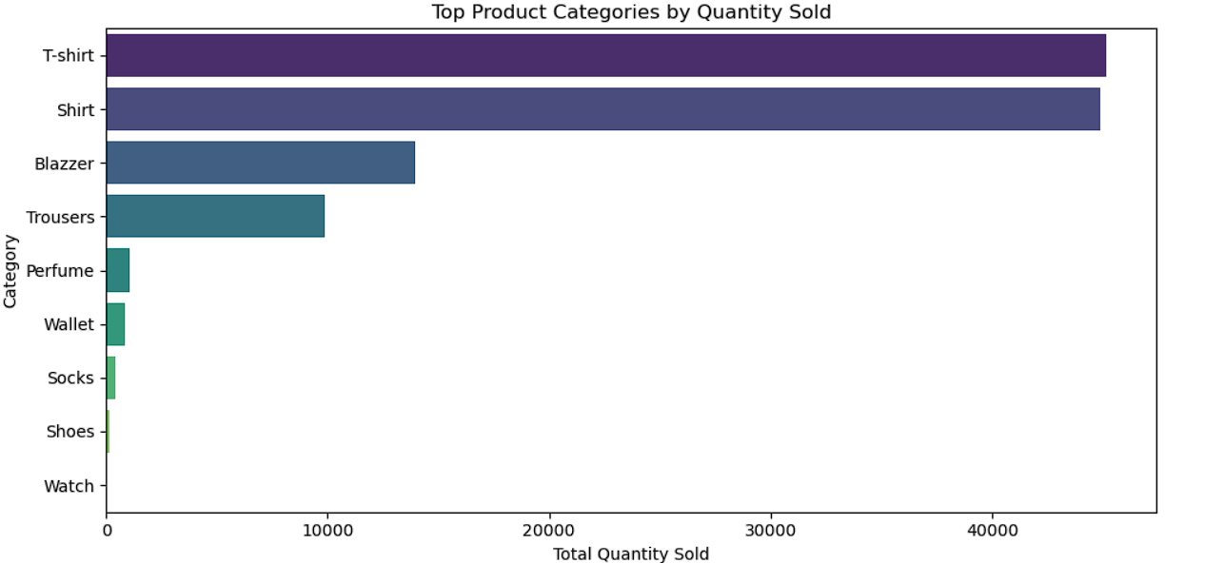
A Bar chart is used to visualize the products sold of the different category.
This Bar chart tells us that maximum products sold were T shirts and Shirts.
We can also see that Watches and Shoes has the minimum sales

Slide 4
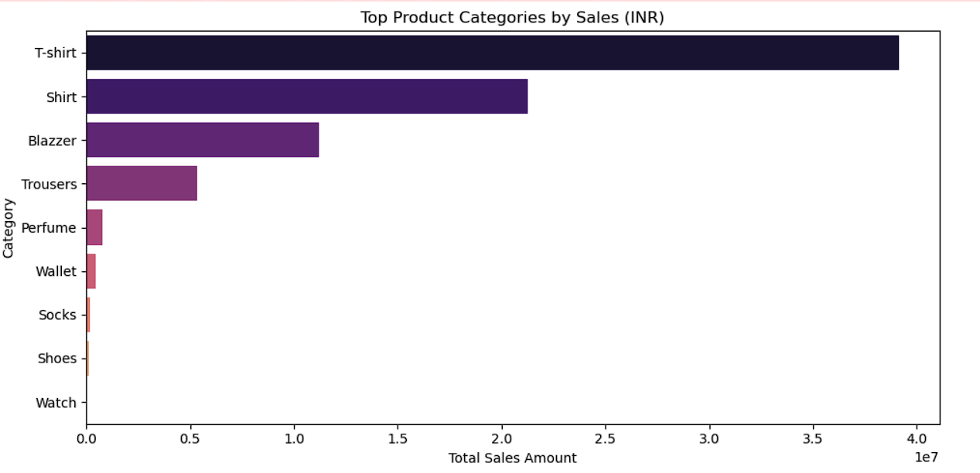
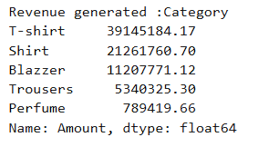
This Bar chart shows the revenue generated by the different products
T-Shirt and Shirt has generated the highest revenue.
Watch and Shoes has generated the minimum revenue i.e INR 915 and INR 123933.76 respectively

Slide 5
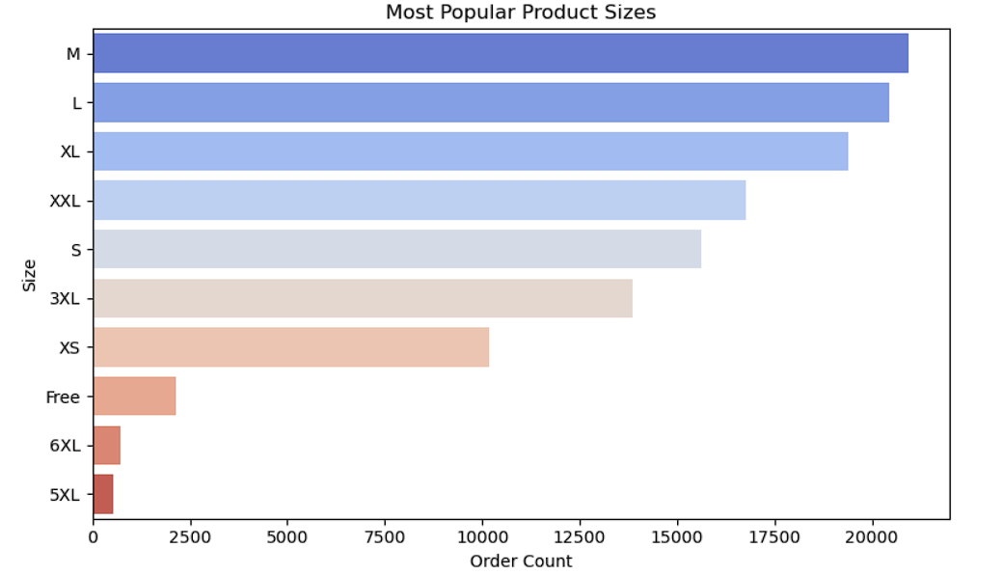
This Bar chart shows the most popular size – M , L , XL
Revenue generated by M – 13674881.13 , L – 13018253.84 , XL- 12238302.38

Slide 6
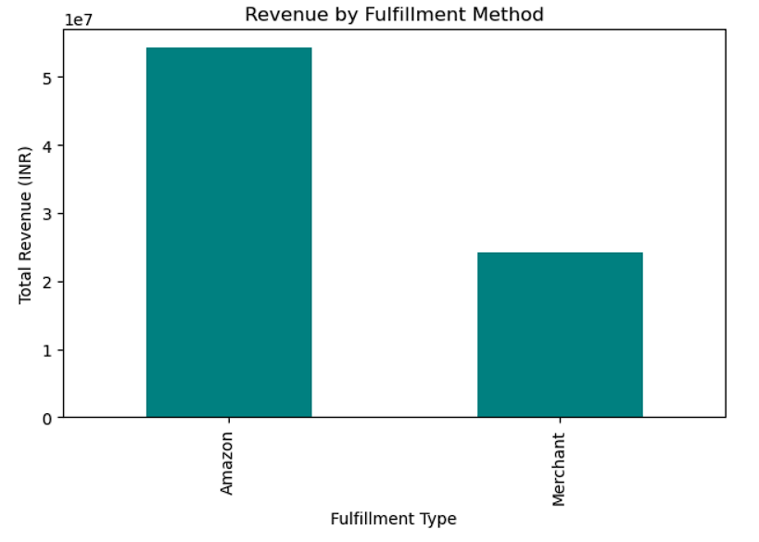
Revenue generated by Fulfillment Method .
Amazon – 54251299 , Merchant – 24226816.39

Slide 7
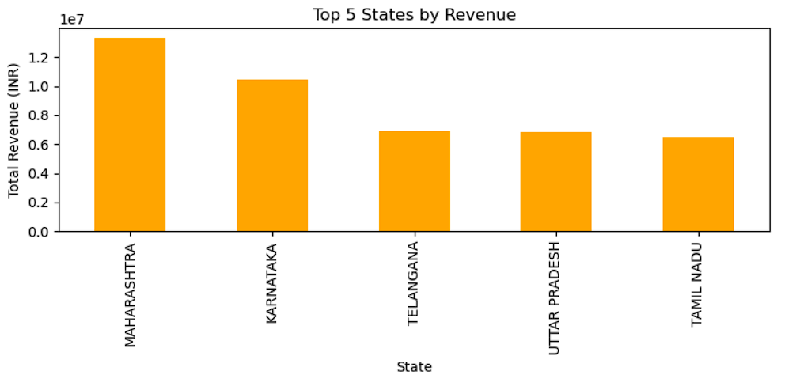
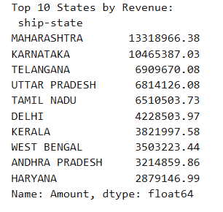
The Bar chat mentions the most revenue generated by the States .
Top 5 States are Maharashtra , Karnataka , Telangana , Uttar Pradesh , Tamil Nadu .

Slide 8
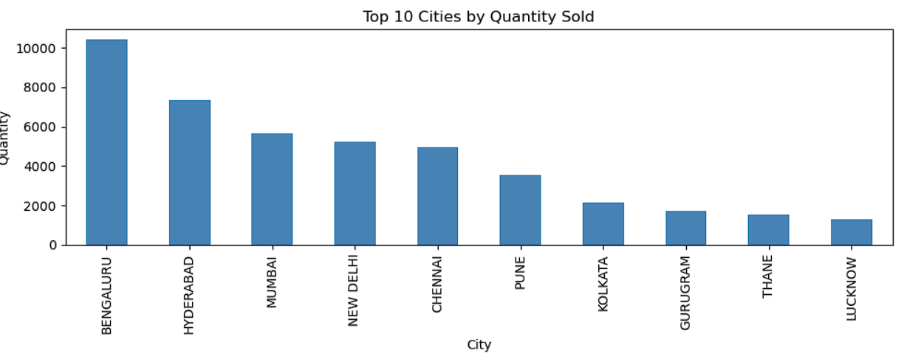
The bar chat shows the Cities in which the most quantity was sold .
Top 5 cities are Bengaluru , Hyderabad , Mumbai , New Delhi , Chennai .

Slide 9
Product Preferences
Top-Selling Categories :
T-shirts and Shirts lead in both quantity sold and revenue. Trousers and Blazers follow as strong secondary performers.
Most Preferred Sizes :
Sizes M, L, and XL account for the majority of purchases — indicating a standard customer size preference range
Category-Specific Trends:
Shirts dominate revenue, indicating they may be priced higher or seen as more premium, while T-shirts are most frequent in quantity, indicating high volume and accessibility

Slide 10
Customer Behaviour
B2C Dominance :
Over 99% of orders are from B2C customers, indicating the primary audience is individual retail shoppers.
High-Value Customers :
A significant portion of revenue is driven by high-value orders (>1000), even though they represent a smaller order count - suggesting opportunities for loyalty or premium targeting.
Fulfillment Preference :
Customers receiving orders via Amazon FBA experience better delivery success, contributing to fewer cancellations and potentially higher satisfaction.

Slide 11
Geographical Sales Distribution
Top Revenue States :
Maharashtra, Karnataka, and Telangana top the list for overall revenue contribution.
Top Quantity Cities :
Cities like Bengaluru, Mumbai, and Hyderabad are the most active in terms of unit sales.
Regional Demand Clusters :
Southern and Western India show the strongest demand, while Tier 2 and Tier 3 cities present room for growth via tailored offers and inventory support.

Slide 12
Expected Outcome
Expected Outcome by conducting a thorough analysis of the Amazon sales report, the goal is to uncover valuable, data-driven insights that can be leveraged to:
Optimize business operations (inventory planning, fulfillment strategy)
Enhance customer experience (delivery reliability, product availability)
Drive revenue growth (targeted promotions, category focus, high-value customer retention)

Slide 13
Summary
1. TOP REVENUE DRIVERS :
Maharashtra and Karnataka are the highest revenue-generating states.
Product category like T-shirts and Shirts dominate in both units sold and revenue.
RECOMMENDATION :
Focus marketing and stock allocation in top-performing states.
Priortize best-selling categories for replenishment and promotions.
2. POPULAR SIZES :
Sizes like M, L and XL are ordered most frequently
High sales concentration around a few sizes
RECOMMENDATION :
Optimize inventory for top 3 sizes
Consider bundling popular sizes or offering combo packs

Slide 14
Summary
3. FULFILLMENT METHOD EFFECTIVENESS
Amazon-fulfilled orders generate 2 times the revenue of merchant-fulfilled ones.
Delivery success rate for Amazon: 71%, higher than merchants (29%).
RECOMMENDATION
Increase use of Amazon Fulfillment to reduce cancellations and improve delivery rates.
Provide training/support for merchants with poor fulfillment stats.
4. B2B vs B2C PATTERNS
Majority of sales (99%) are B2C.
B2B sales are minimal but have higher average order value.
RECOMMENDATION:
Explore potential in B2B by offering bulk order discounts or exclusive categories.
Build B2B outreach campaigns to expand that channel.

Slide 15
Summary
5. REGIONAL GROWTH OPPORTUNITY
States like Delhi, Kerala, and Haryana show decent revenue but aren’t in top for quantity.
RECOMMENDATION
These regions may respond well to promotions or targeted ads.
Explore why unit sales are low — pricing? shipping delays? inventory?
6. HIGH-VALUE ORDERS
We found over ₹1.6 Cr revenue from just 13,000 high-value orders.
RECOMMENDATION:
Focus on upselling or loyalty programs for high-value customers.
Introduce premium or personalized shopping experiences.

